Slide 1







GROUP
PROJECT
By Team SG

Slide 2


Our Team
Narbutaeva Elmara 12214711
Bakhromov Makhmudbek 12214685
Abdurakhmonova Makhinur 12220241
Junrui Chan 12250106

Slide 3

What is Educational Technology?
The use of hardware (e.g., computers, tablets), software (e.g., learning apps), and methodologies (e.g., blended learning) to enhance teaching and learning.

Slide 4

Why is this Topic Important?
Improves accessibility, personalization, and engagement in education.
Essential for adapting to the digital age and preparing students for the future.

Slide 5
The Gap or Problem You Aim to Address:
Despite its potential, there is limited data on how educational technology is used, its effectiveness, and the challenges faced by users.
This project will survey students and teachers to provide clarity on these issues.

Slide 6
Project Objectives
Analyzing the Impact of Educational Technology
Identifying Usage trends
Measuring Satisfaction and Challenges
Providing Actionable Insights

Slide 7
Survey Design
Participants: 30 individuals (students)
Survey Tool: Google Forms
Our Purpose: To explore user behavior, preferences, satisfaction and perceived effectiveness of EdTech tools
Sample Questions used in Survey:
How frequently do you use EdTech tools (e.g., apps, platforms, LMS)?
What type of EdTech tools do you use the most?
Do you feel these tools improve your learning experience?
What challenges do you face when using EdTech?

Slide 8
Preliminary Survey Results
Survey Participants: 30
Target Group: Inha University students
EdTech Usage Frequency
Daily 43% Several times a week 37% Once a week 13 % Rarely/Never 7%
2. Favorite EdTech Platforms
YouTube (educational content) 30% Coursera 20% Khan Academy 15%
ChatGPT or AI Tools 20% Others (e.g., Notion, Edmodo, custom LMS) 15%
3. Perceived Impact on Learning
Strongly Agree 35% Agree 40% Neutral 15% Disagree 10% Strongly Agree 0%
4. Main Challenges in using EdTech
Internet or Technical Issues 35% Lack of motivation/Self-discipline 30% Unclear
Instructions/Lack of human support 20% Complicated UI/App Fatigue 15%

Slide 9


Tools & Methods
1
2
For data collection
For data analysis
Google Form
Python
It is a free questionnaire tool provided by Google. It enables users to conveniently create, share, and analyze questionnaires, and is suitable for individuals and small teams.
A general-purpose programming language that supports statistical analysis and machine learning through third-party libraries.
Qualtrics
SPSS
It is a well-known online survey platform that provides powerful data analysis and visualization tools. It allows users to customize the questionnaire style, gain an in-depth understanding of respondents' feedback
A professional statistical software with a user-friendly interface and no need for programming. Simple operation (menu-driven), suitable for beginners, and a standard tool in the field of social sciences.
SurveyMonkey
AMOS
It is a globally renowned online questionnaire tool with powerful functions. It offers a rich variety of questionnaire design options and analysis functions, and has a wide range of user groups
Special software for structural equation modeling (SEM), usually as an extension module of SPSS.

Slide 10
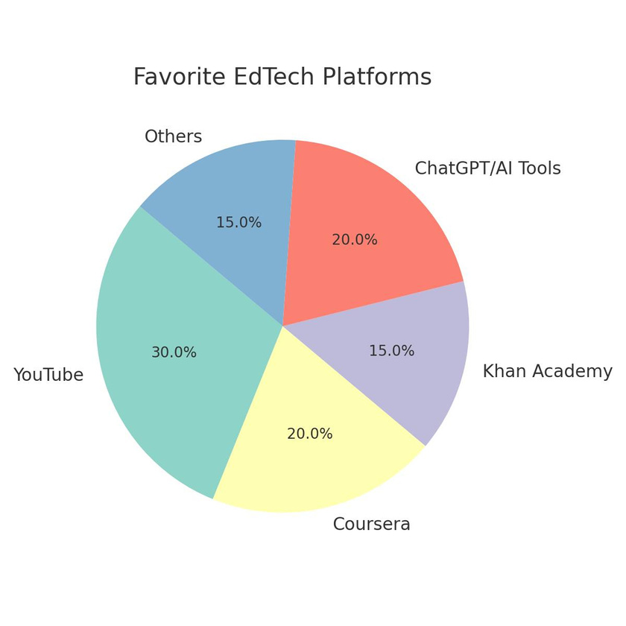
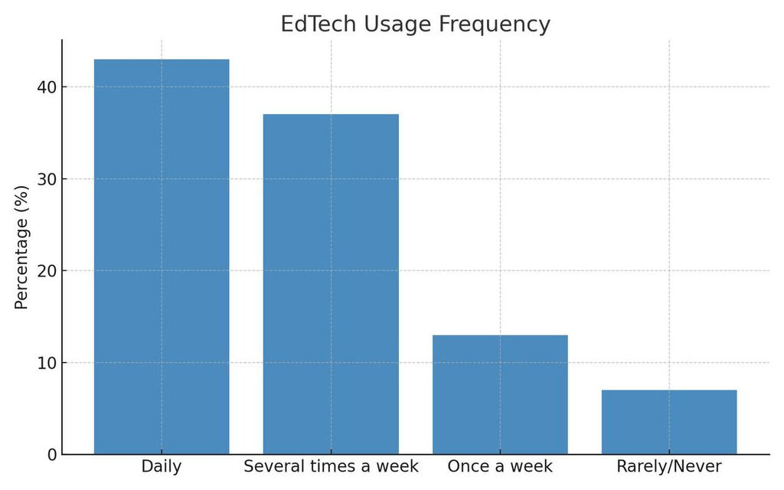
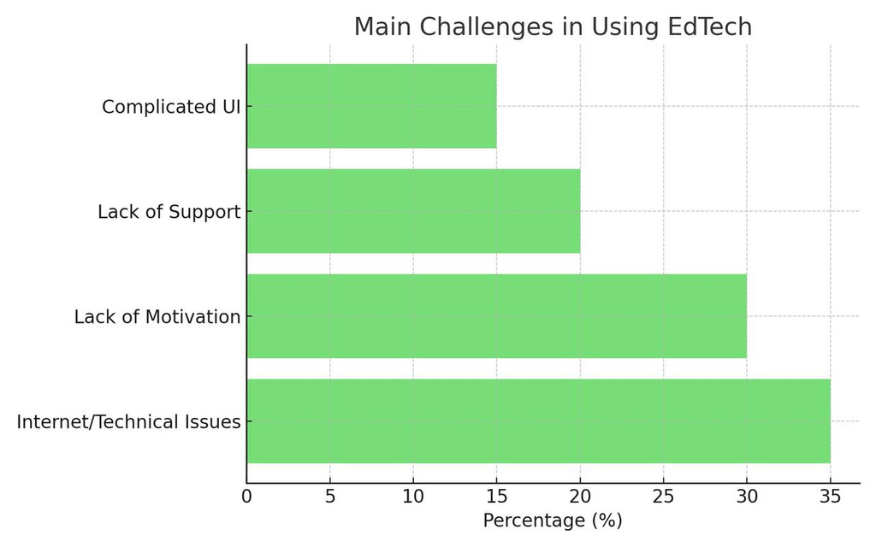
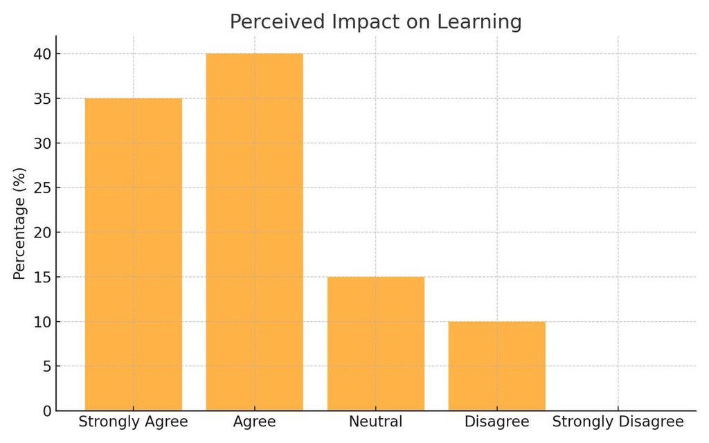

Slide 11
Action Plan & Timeline
Week 1: Finalize survey design and questions.
Week 2: Pilot test survey and refine based on feedback.
Weeks 3-4: Distribute survey and collect responses.
Week 5: Clean and prepare data for analysis.
Week 6: Analyze data using Excel.
Week 7: Interpret results and draft conclusions.
Week 8: Prepare final presentation and report.

Slide 12
Expected Outcome & Societal Benefit
Predicted Insights:
2
1
Societal Benefit:
2
Usage patterns and trends in educational technology adoption.
Satisfaction levels among students and teachers.
Key challenges and barriers to effective implementation.
Improved educational outcomes through better technology integration.
Informed decision-making for educators and policymakers.
Addressing barriers to enhance accessibility and equity in education.

Slide 13
THANK YOU

